Slide 1
Extensive and intensive state functions
If you know the value of an extensive state function, you could (in principle) back out how many molecules you have. Knowing the value of an intensive state function doesn’t help with that. Examples: n, P, T, V, M, m.
Which are extensive?
Which are intensive?

Slide 2
Extensive and intensive state functions
If you know the value of an extensive state function, you could (in principle) back out how many molecules you have. Knowing the value of an intensive state function doesn’t help with that. Examples: n, P, T, V, M, m.
Which are extensive? n, V (and U, which we’ll get to next)
Which are intensive? P, T, M, m

Slide 3
What internal energy (“U”) is
It’s all the molecular energy in a given sample. We divide it into these parts
The kinetic part is energy of motion: translational, rotational, and vibrational motions
The potential part is like the energy in a compressed spring – not moving, but energy that’s potentially available. At the molecular level, we talk about the potential energy of vibration, in that a molecule could be compressed or stretched out (much like a spring). Translational and rotational motions don’t have potential energy.

Slide 4
Degrees of freedom
What’s a degree of freedom? For starters, each direction in space is 1 degree of freedom.
This molecule has three degrees of translational freedom

Slide 5
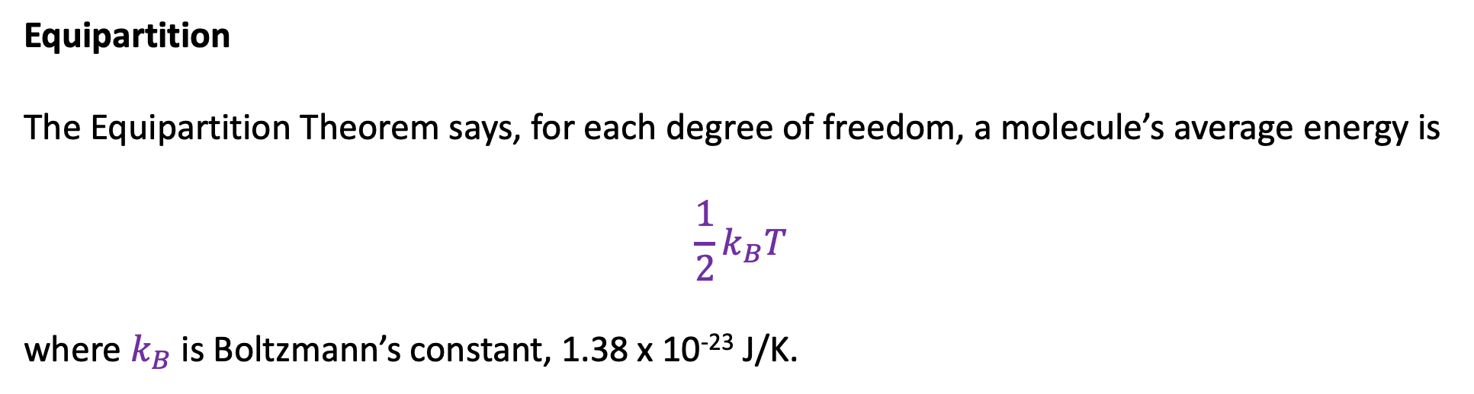
Equipartition
The Equipartition Theorem says, for each degree of freedom, a molecule’s average energy is
$$\frac{1}{2}k_{B}T$$
where $k_{B}$ is Boltzmann’s constant, 1.38 x 10⁻²³ J/K.
This molecule will have, on average, and energy of $\frac{3}{2}k_{B}T$

Slide 6
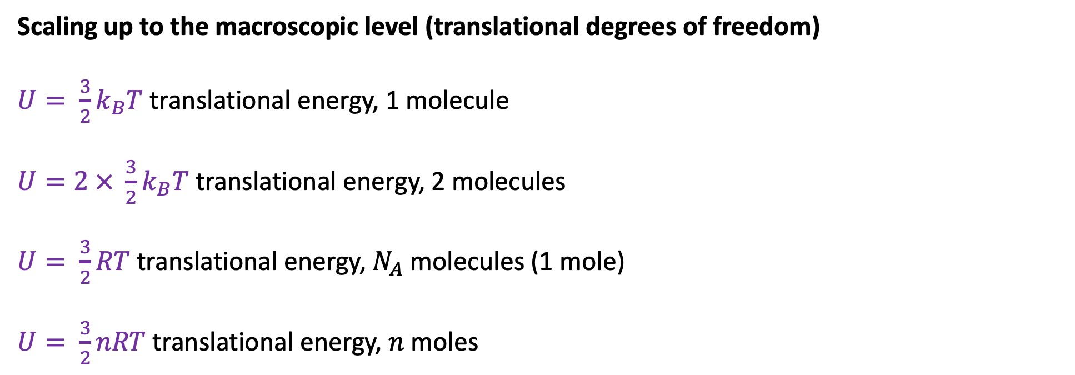
Scaling up to the macroscopic level (translational degrees of freedom)
$U= \frac{3}{2}k_{B}T$ translational energy, 1 molecule
$U=2 × \frac{3}{2}k_{B}T$ translational energy, 2 molecules
$U= \frac{3}{2}RT$ translational energy, $N_{A}$ molecules (1 mole)
$U= \frac{3}{2}nRT$ translational energy, $n$moles

Slide 7
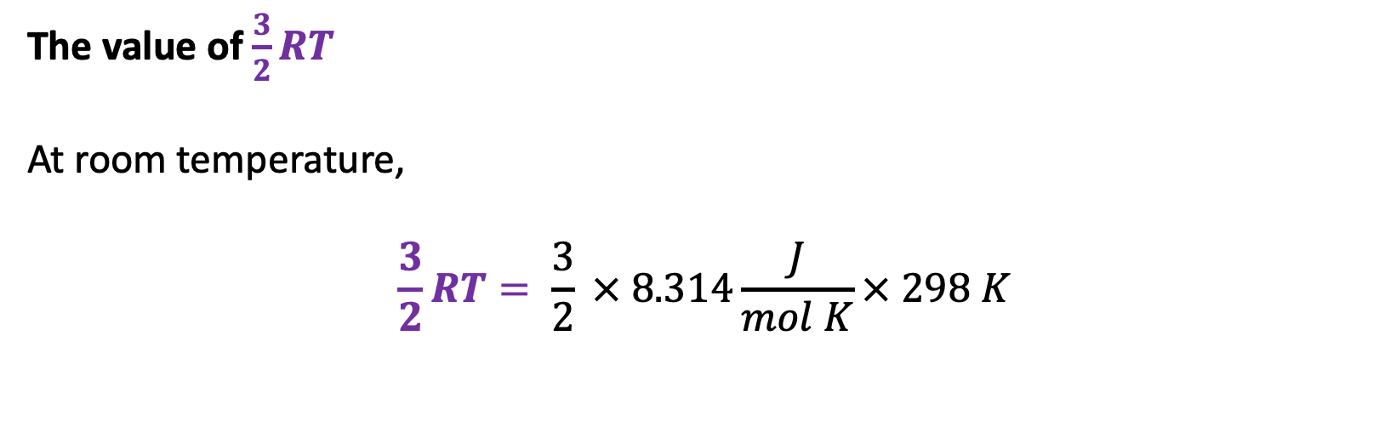
The value of $\frac{3}{2}RT$
At room temperature,
$$\frac{3}{2}RT= \frac{3}{2} × 8.314\frac{J}{mol K}× 298 K$$

Slide 8

The value of $\frac{3}{2}RT$
At room temperature,
$$\frac{3}{2}RT= \frac{3}{2} × 8.314\frac{J}{mol K}× 298 K$$
$≈4000\frac{J}{mol}$ = $4\frac{kJ}{mol}$

Slide 9
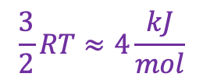
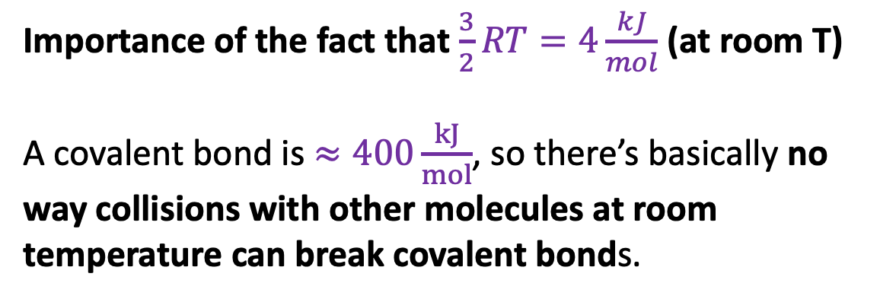
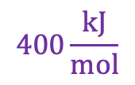
Importance of the fact that $\frac{3}{2}RT=4\frac{kJ}{mol}$ (at room T)
A covalent bond is $≈400\frac{kJ}{mol}$, so there’s basically no way collisions with other molecules at room temperature can break covalent bonds.
$$400\frac{kJ}{mol}$$
C
H
$$\frac{3}{2}RT≈4\frac{kJ}{mol}$$
N
N

Slide 10
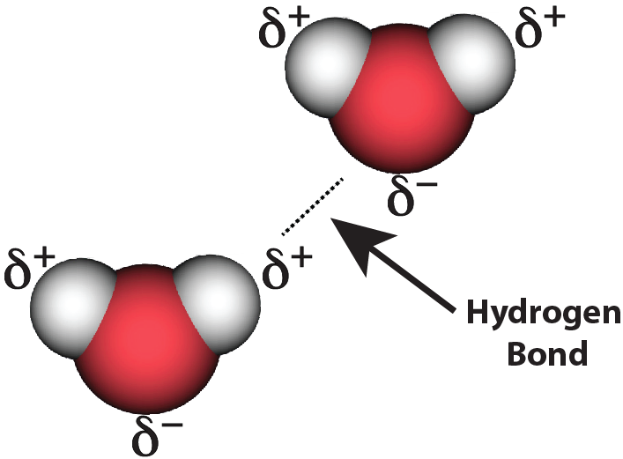
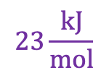
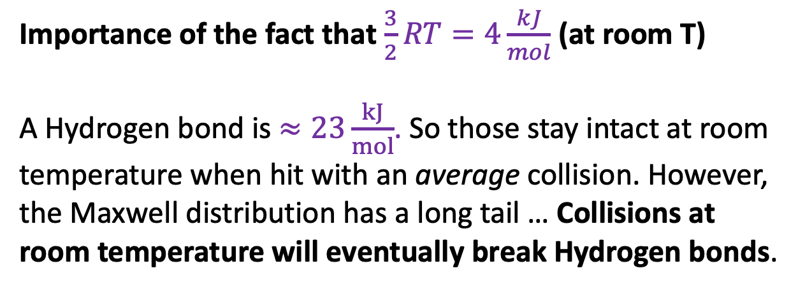
Importance of the fact that $\frac{3}{2}RT=4\frac{kJ}{mol}$ (at room T)
A Hydrogen bond is $≈23\frac{kJ}{mol}$. So those stay intact at room temperature when hit with an average collision. However, the Maxwell distribution has a long tail … Collisions at room temperature will eventually break Hydrogen bonds.
$$23\frac{kJ}{mol}$$
$$\frac{3}{2}RT≈4\frac{kJ}{mol}$$
N
N

Slide 11
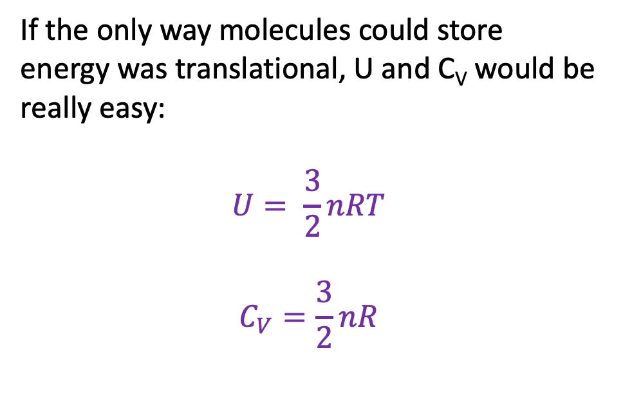
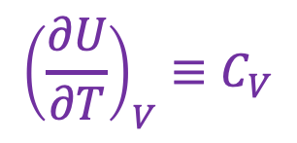
U as a thermodynamic surface
$${\left(\frac{∂U}{∂T}\right)}_{V}≡C_{V}$$
U(T,V)
If the only way molecules could store energy was translational, U and C_{V} would be really easy:
$$U= \frac{3}{2}nRT$$
$$C_{V}=\frac{3}{2}nR$$
V
“State Space”
T
Isochoric heating

Slide 12
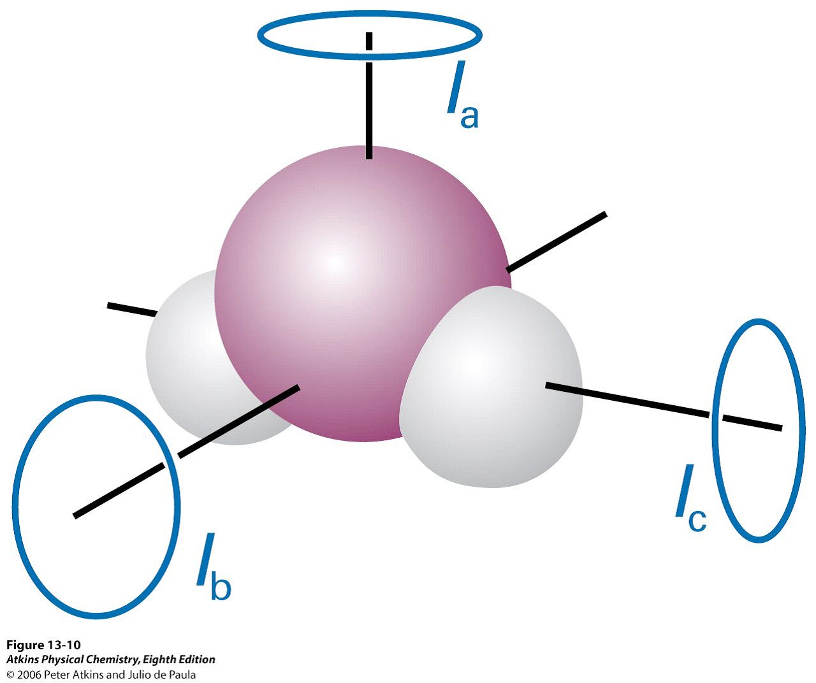
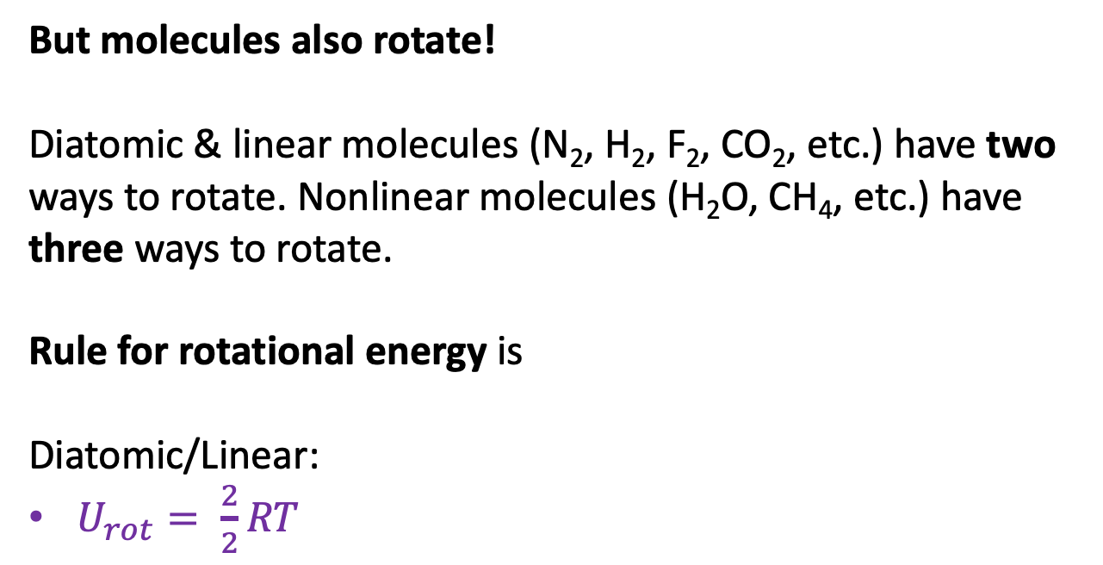
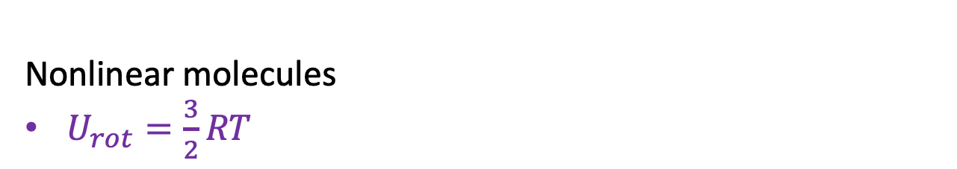
But molecules also rotate!
Diatomic & linear molecules (N₂, H₂, F₂, CO₂, etc.) have two ways to rotate. Nonlinear molecules (H₂O, CH₄, etc.) have three ways to rotate.
Rule for rotational energy is
Diatomic/Linear:
$U_{rot}= \frac{2}{2}RT$
N
Rotating in-plane and out-of-plane
N
Nonlinear molecules
$U_{rot}=\frac{3}{2}RT$
Rotating in three distinct directions

Slide 13
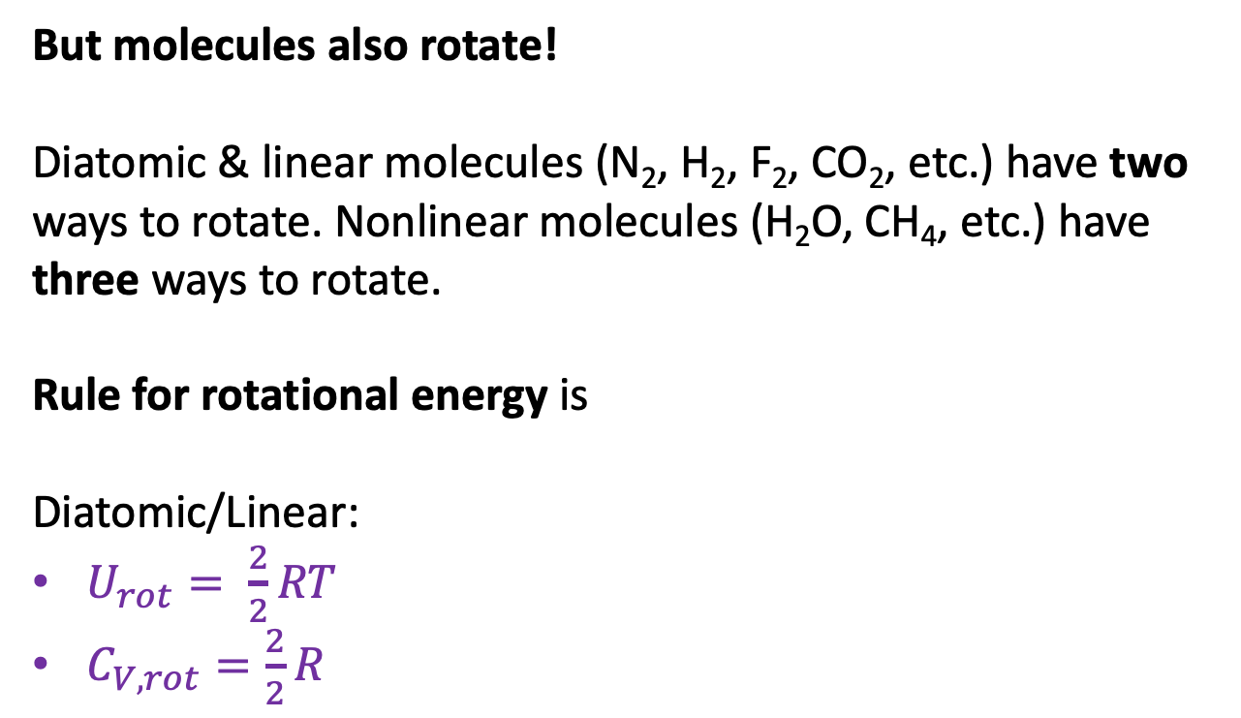
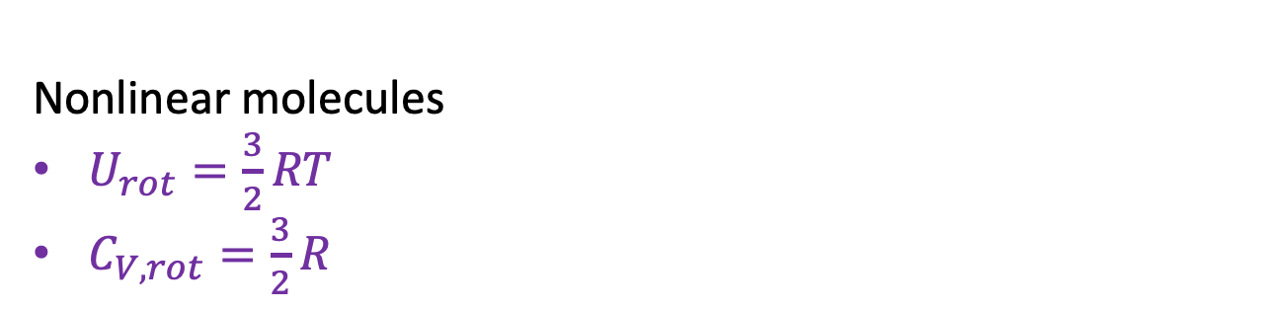
But molecules also rotate!
Diatomic & linear molecules (N₂, H₂, F₂, CO₂, etc.) have two ways to rotate. Nonlinear molecules (H₂O, CH₄, etc.) have three ways to rotate.
Rule for rotational energy is
Diatomic/Linear:
$U_{rot}= \frac{2}{2}RT$
$C_{V,rot}=\frac{2}{2}R$
N
Rotating in-plane and out-of-plane
N
Nonlinear molecules
$U_{rot}=\frac{3}{2}RT$
$C_{V,rot}=\frac{3}{2}R$
Rotating in three distinct directions

Slide 14
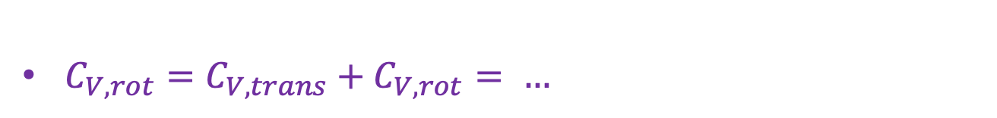

Energy of rotations combined with translations
Diatomic/linear:
N
Rotating in-plane and out-of-plane
N
$U=U_{trans}+U_{rot}= …$
$C_{V,rot}=C_{V,trans}+C_{V,rot}= …$
Rotating in three distinct directions

Slide 15

Energy of rotations combined with translations
Diatomic/linear:
N
Rotating in-plane and out-of-plane
N
$U=U_{trans}+U_{rot}=\frac{5}{2}RT$
$C_{V,rot}=C_{V,trans}+C_{V,rot}= …$
Rotating in three distinct directions

Slide 16
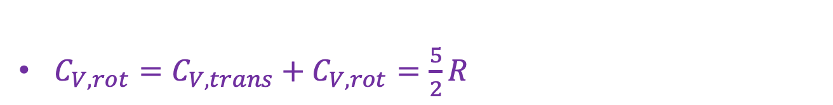
Energy of rotations combined with translations
Diatomic/linear:
N
Rotating in-plane and out-of-plane
N
$U=U_{trans}+U_{rot}=\frac{5}{2}RT$
$C_{V,rot}=C_{V,trans}+C_{V,rot}=\frac{5}{2}R$
Rotating in three distinct directions

Slide 17
Energy of rotations combined with translations
Nonlinear molecules:
N
Rotating in-plane and out-of-plane
N
$U=U_{trans}+U_{rot}= …$
$C_{V,rot}=C_{V,trans}+C_{V,rot}= …$
Rotating in three distinct directions

Slide 18

Energy of rotations combined with translations
Nonlinear molecules:
N
Rotating in-plane and out-of-plane
N
$U=U_{trans}+U_{rot}=\frac{6}{2}RT$
$C_{V,rot}=C_{V,trans}+C_{V,rot}= …$
Rotating in three distinct directions

Slide 19

Energy of rotations combined with translations
Nonlinear molecules:
N
Rotating in-plane and out-of-plane
N
$U=U_{trans}+U_{rot}=\frac{6}{2}RT$
$C_{V,rot}=C_{V,trans}+C_{V,rot}=\frac{6}{2}R$
Rotating in three distinct directions

Slide 20
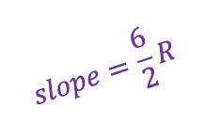

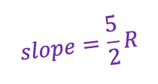



Bigger molecules => steeper increase in U as temperature increases & bigger heat capacities
$$slope=\frac{6}{2}R$$
$U=\frac{6}{2}RT$ (nonlinear molecules)
U
$$slope=\frac{5}{2}R$$
$U=\frac{5}{2}RT$ (diatomic/linear molecules)
$$\frac{6}{2}R$$
C_{V}
$$\frac{5}{2}R$$
T

Slide 21
Bigger molecules => steeper increase in U as temperature increases & bigger heat capacities
$$slope=\frac{6}{2}R$$
$U=\frac{6}{2}RT$ (nonlinear molecules)
U
$$slope=\frac{5}{2}R$$
$U=\frac{5}{2}RT$ (diatomic/linear molecules)
But don’t get too attached to this picture because the slope can change even for a given molecule!
$$\frac{6}{2}R$$
C_{V}
$$\frac{5}{2}R$$
T

Slide 22

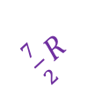
Nonlinear changes in U(T) and C_{V}(T)
$$slope=\frac{6}{2}R$$
U
$\frac{7}{2}R$
$$slope=\frac{5}{2}R$$
Why?
$\frac{7}{2}R$
$$\frac{6}{2}R$$
C_{V}
$$\frac{5}{2}R$$
T
T*

Slide 23
Nonlinear changes in U(T) and C_{V}(T) => activating vibrational motion!
$$slope=\frac{6}{2}R$$
U
$\frac{7}{2}R$
U gets steeper – and the heat capacity increases – because the molecule has crossed a vibrational threshold, T*.
When T<T*, molecules are not vibrating.
When T<T*, molecules are vibrating.
$$slope=\frac{5}{2}R$$
Not vibrating
vibrating
$\frac{7}{2}R$
$$\frac{6}{2}R$$
C_{V}
$$\frac{5}{2}R$$
T
T*

Slide 24
The classical limit
$$slope=\frac{6}{2}R$$
U
$\frac{7}{2}R$
This transition is actually a quantum effect that only occurs at low temperature. For that reason, the high-temperature limit of C_{V} is also called the classical limit.
$$slope=\frac{5}{2}R$$
Not vibrating
vibrating
$\frac{7}{2}R$
$$\frac{6}{2}R$$
C_{V}
$$\frac{5}{2}R$$
T
T*
High-temperature (classical) limit

Slide 25
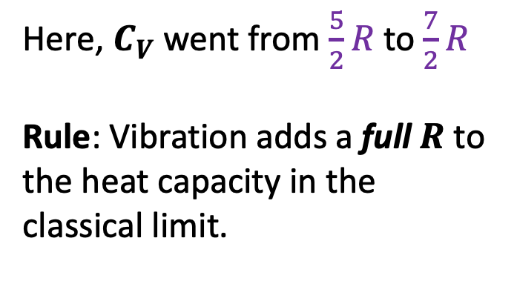
Rule for heat capacities in the classical limit
$$slope=\frac{6}{2}R$$
U
$\frac{7}{2}R$
$$slope=\frac{5}{2}R$$
Here, $C_{V}$went from $\frac{5}{2}R$to $\frac{7}{2}R$
Rule: Vibration adds a full $R$ to the heat capacity in the classical limit.
Not vibrating
vibrating
$\frac{7}{2}R$
$$\frac{6}{2}R$$
C_{V}
$$\frac{5}{2}R$$
T
T*
High-temperature (classical) limit

Slide 26
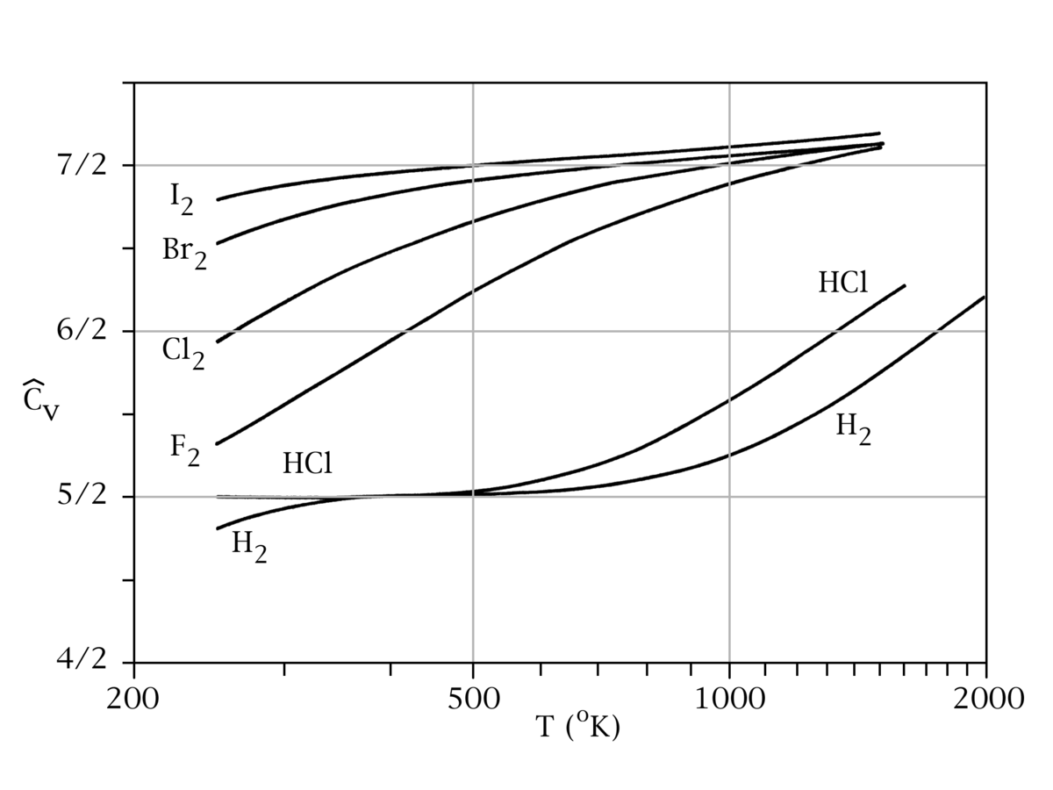
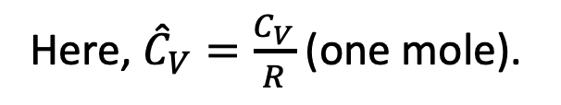
Real heat capacity data
Here, ${\hat{C}}_{V}=\frac{C_{V}}{R}$ (one mole).
Anything strike you about these data?

Slide 27
Real heat capacity data
Here, ${\hat{C}}_{V}=\frac{C_{V}}{R}$ (one mole).
Focus on HCl first

Slide 28
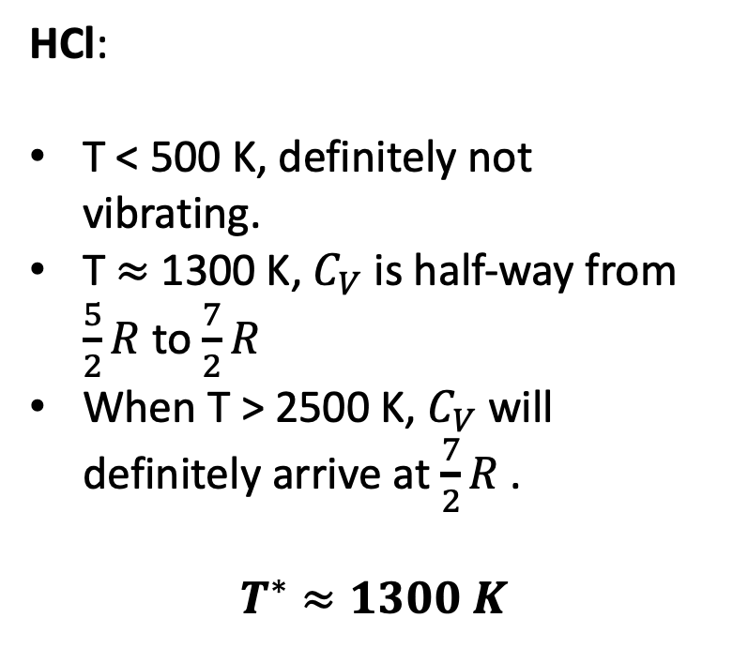
Real heat capacity data
Here, ${\hat{C}}_{V}=\frac{C_{V}}{R}$ (one mole).
HCl:
T < 500 K, definitely not vibrating.
T $≈$ 1300 K, $C_{V}$is half-way from $\frac{5}{2}R$ to $\frac{7}{2}R$
When T > 2500 K, $C_{V}$will definitely arrive at $\frac{7}{2}R$ .
$$T^{∗}≈1300 K$$

Slide 29
Real heat capacity data
Here, ${\hat{C}}_{V}=\frac{C_{V}}{R}$ (one mole).
What do you make of F₂?

Slide 30
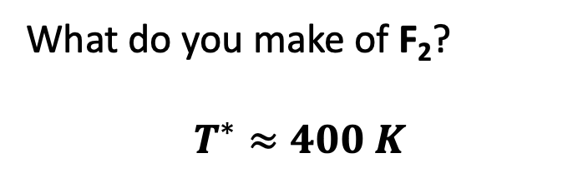
Real heat capacity data
Here, ${\hat{C}}_{V}=\frac{C_{V}}{R}$ (one mole).
What do you make of F₂?
$$T^{∗}≈400 K$$

Slide 31
Real heat capacity data
Here, ${\hat{C}}_{V}=\frac{C_{V}}{R}$ (one mole).
What do you make of H₂?

Slide 32
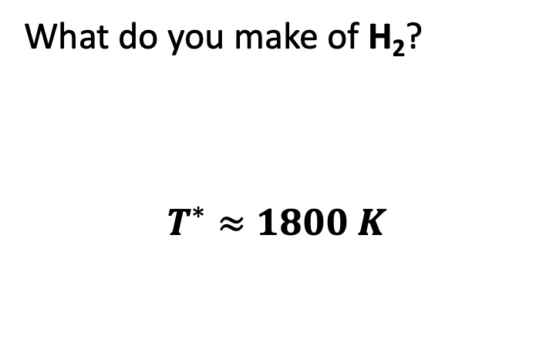
Real heat capacity data
Here, ${\hat{C}}_{V}=\frac{C_{V}}{R}$ (one mole).
What do you make of H₂?
$$T^{∗}≈1800 K$$

Slide 33
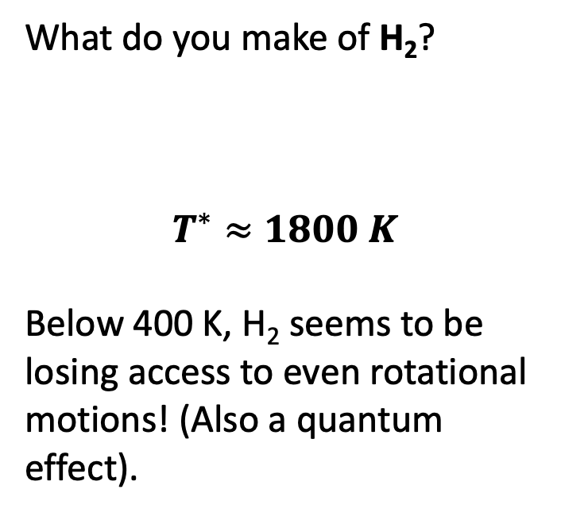
Real heat capacity data
Here, ${\hat{C}}_{V}=\frac{C_{V}}{R}$ (one mole).
What do you make of H₂?
$$T^{∗}≈1800 K$$
Below 400 K, H₂ seems to be losing access to even rotational motions! (Also a quantum effect).

Slide 34
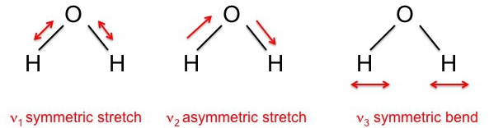
Polyatomic molecules actually have multiple vibrational modes
Polyatomic molecules have multiple vibrational modes. At high temperature, all become active, each at a slightly different temperature.
Example: H₂O has three vibrational modes.

Slide 35
New rule for heat capacities of polyatomic molecules in the classical limit
Polyatomic molecules have multiple vibrational modes. At high temperature, all become active, each at a slightly different temperature.
Example: H₂O has three vibrational modes.
In the high-temperature limit, each vibration will add a full $R$ to the heat capacity for each vibrational mode!

Slide 36
Let’s do a full analysis of water …
Write down C_{V} in the low-temperature limit
Write down C_{V} in the high-temperature limit
Putting T* at about the middle of your x-axis, sketch U(T) and C_{V} (T)

Slide 37
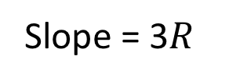
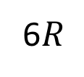
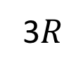
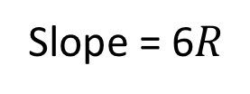
Let’s do a full analysis of water …
Write down C_{V} in the low-temperature limit
Write down C_{V} in the high-temperature limit
Putting T* at about the middle of your x-axis, sketch U(T) and C_{V} (T)
Slope = 6$R$
U(T)
Slope = 3$R$
C_{V}(T)
6$R$
3$R$
T*
T

Slide 38
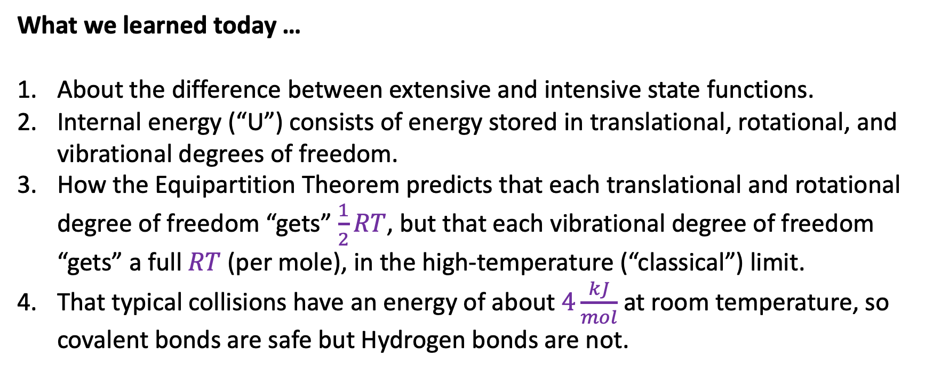
What we learned today …
About the difference between extensive and intensive state functions.
Internal energy (“U”) consists of energy stored in translational, rotational, and vibrational degrees of freedom.
How the Equipartition Theorem predicts that each translational and rotational degree of freedom “gets” $\frac{1}{2}RT$, but that each vibrational degree of freedom “gets” a full $RT$ (per mole), in the high-temperature (“classical”) limit.
That typical collisions have an energy of about $4\frac{kJ}{mol}$ at room temperature, so covalent bonds are safe but Hydrogen bonds are not.

